Slide 1

Group 14 Vikings vs Spartans
Level 4/5 Group 14: Ethan Ward, Petrut Vasile, Toby White

Slide 2
How the game fits the brief
E
Symmetrical 2D
turn based multiplayer game
played on a single mobile device
controlled by tapping
Notes:
The Assignment
2D Game
Main control mechanic is a simple tap
Multiplayer – by taking turns
On a single device
Symmetric
Simple and intuitive rules
The gameplay experience should be
Engaging
Focused
Polished
Why mobile?
Growing at a phenomenal pace
Why tap?
Casual Users don’t have years of gaming experience
Casual Users don’t have the dexterity of gamers
Casual Users play on their phone to pass time
So everyone can play the game
Supports all kinds of users
Easy to control and understand but difficult to master!
Why multiplayer?
The competitive nature of the game makes it easy for users to commit to it giving your game a higher retention than single player games.
It creates a feeling of urgency as both players progress through gameplay and approach the “finish line”.
Opponents are also a strong tool in making an experience that is always fresh.

Slide 3
Target audience
T
Core audience
Casual mobile gamers
Ages between
14 - 35
Male

Slide 4
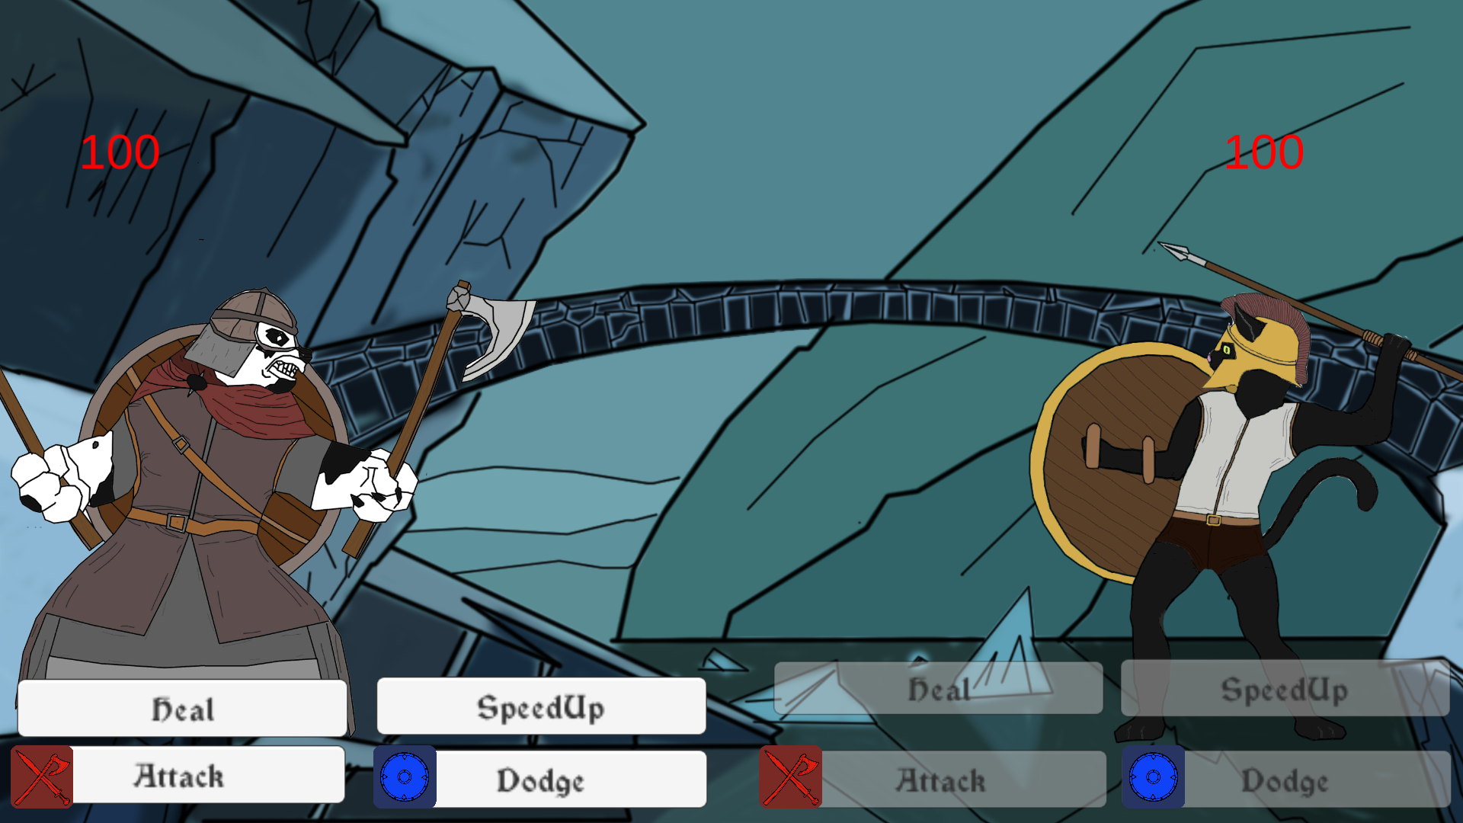
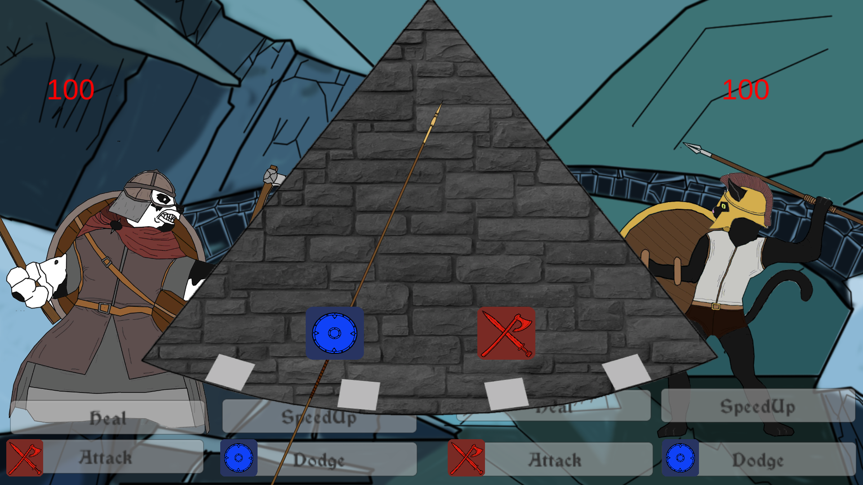
How we iterated based on feedback
E
Notes:
Add in screen shot of buttons/symbols
And the single pendulum
Single set of buttons
More ways to play
More intuitive

Slide 5
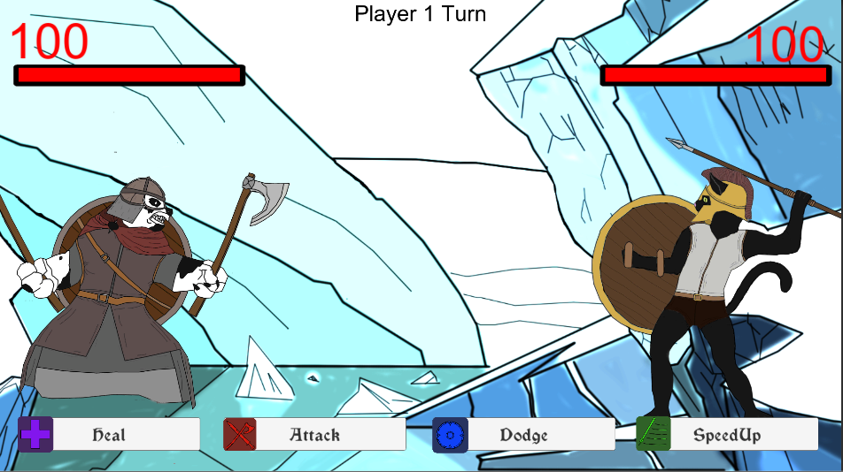
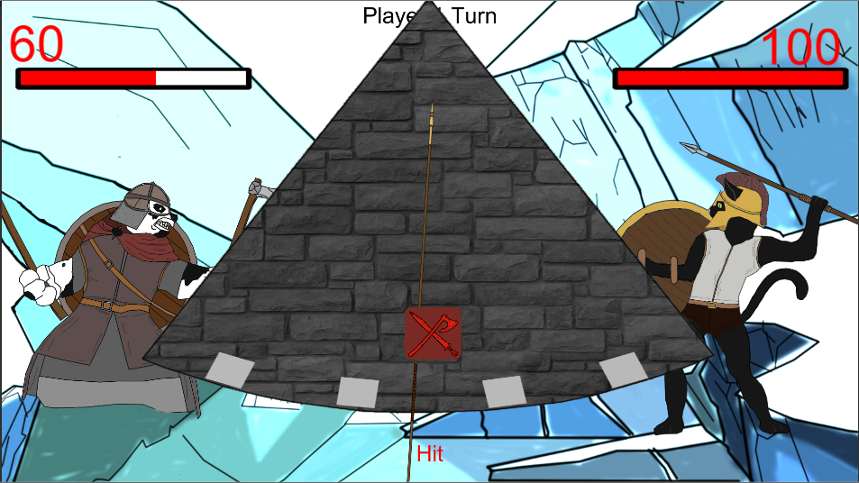
How we iterated based on feedback
E
Notes:
Add in screen shot of buttons/symbols
And the single pendulum
Single set of buttons
More ways to play
More intuitive
Health bar
Only 4 buttons
Hit and miss
Player turn
Visual Hierarchy
Meaningful choice

Slide 6
What does the player do?
P
Notes:
Thinking about removing the buttons in the main level as it is just another step for the player

Slide 7
Mechanics:
P
Attack
Dodge
Speed up
Heal
Pendulum

Slide 8
The player experience & emotions
T
Desired emotions:
Joy, Fear.
Relief, Nervousness.
We aim for:
People Fun.
Schadenfreude.
Fiero.
Notes:
On the side of the player experience, we aim for the primary emotions of Fear and Joy (joy for hitting and fear of the enemy hitting). The secondary emotions we target are the Relief and Nervousness, linked to the primary emotion of Fear.
Being a 2 player game, our first goal is to achieve a sense of people fun. This comes packaged with the emotion of schadenfreude
Having a twitch mechanic as out main game mechanic, we are of course expecting a sense of hard fun, bringing with it the emotion of Fiero.

Slide 9
What are the games challenges?
T
Social
Strategical
Physical challenge
Twitch mechanic

Slide 10
Add in an art slide?

Slide 11
The following week
E
&
P
Polishing the game
Balancing
Notes:
Improve the prototype based on player feedback
Finish the art for the game

Slide 12
Any Questions?

